Slide 1
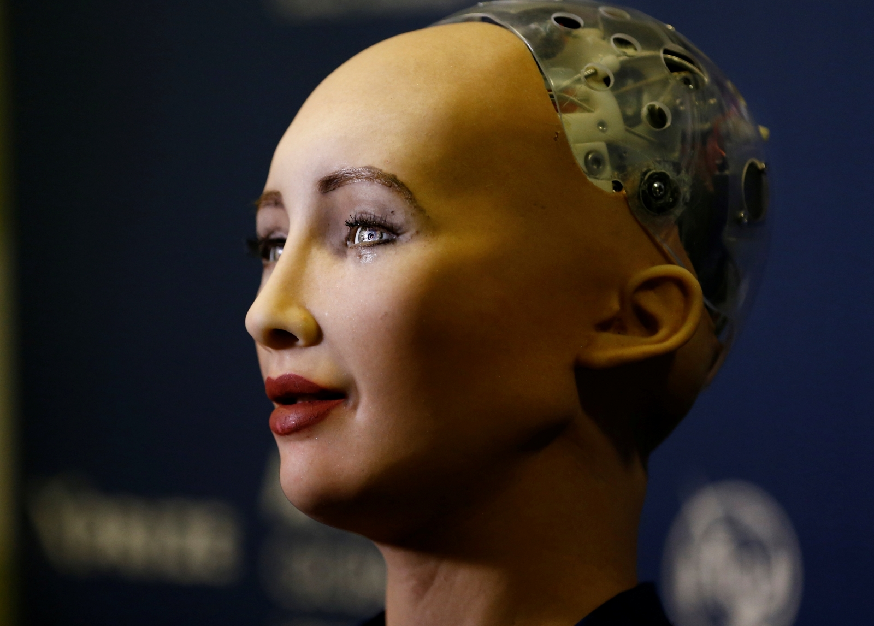
SOPHIA-The Robot
Presented by:
Ch.Hanusri(20RH1A0543)

Slide 2
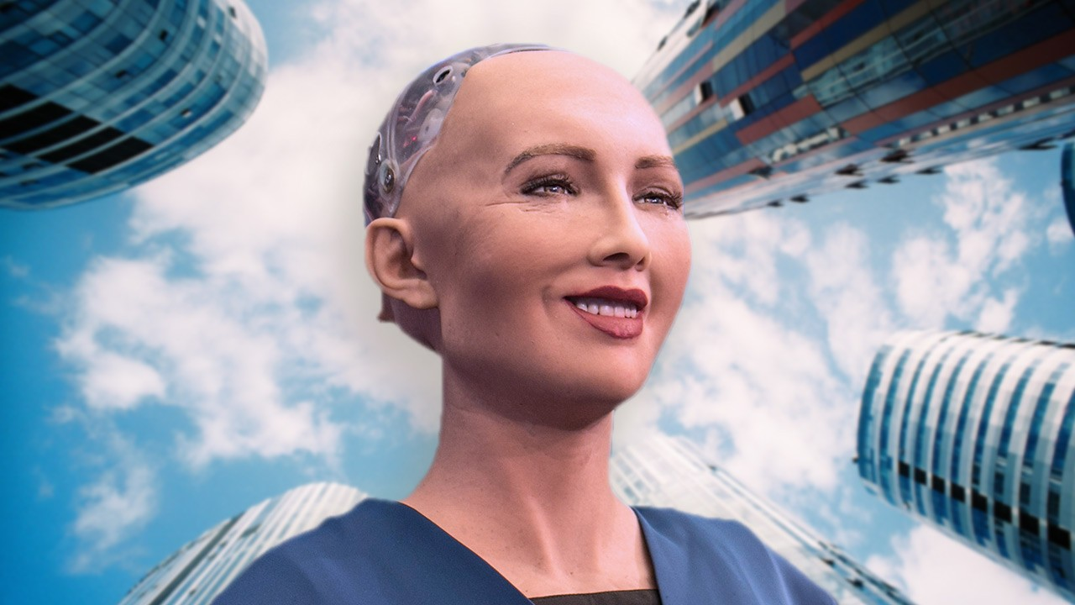
CONTENTS
Introduction
History
Features
Advantages
Disadvantages
References
Conclusion

Slide 3
Introduction
Sophia is a social humanoid robot developed by the Hong Kong-based company Hanson Robotics. Sophia was activated on February 14, 2016, and made her first public appearance in mid-March 2016 at South by Southwest (SXSW) in Austin, Texas, United States.
Sophia has been covered by media around the globe, and has participated in many high-profile interviews. In October 2017, Sophia was given Saudi Arabian citizenship, and became the first robot to receive citizenship of any country.In November 2017, Sophia was named the United Nations Development Programme's first Innovation Champion, and is the first non-human to be given a United Nations title.

Slide 4
History
Sophia was first activated on February 14, 2016. The robot is known for its human-like appearance and behavior compared to previous robotic variants.
As of 2018, Sophia's architecture includes scripting software, a chat system, and OpenCog, an AI system designed for general reasoning.
Sophia imitates human gestures and facial expressions and is able to answer certain questions and to make simple conversations on predefined topics (e.g. on the weather).

Slide 5
Features
A computer vision algorithm processes input from cameras within Sophia's eyes, giving Sophia visual information on its surroundings.
It can follow faces, sustain eye contact, and recognize individuals. It can process speech and have conversations using a natural language subsystem.
Around January 2018, Sophia was upgraded with functional legs and the ability to walk.CNBC has commented on Sophia's "lifelike" skin and its ability to emulate more than 60 facial expressions.
Sophia is conceptually similar to the computer program ELIZA, which was one of the first attempts at simulating a human conversation.

Slide 6
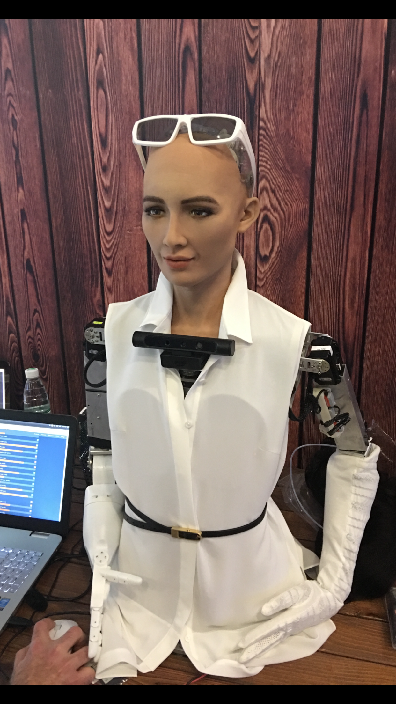
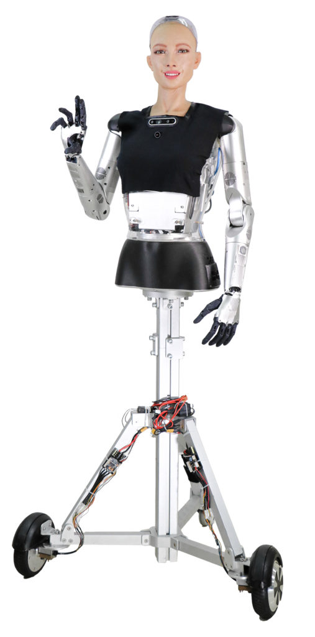
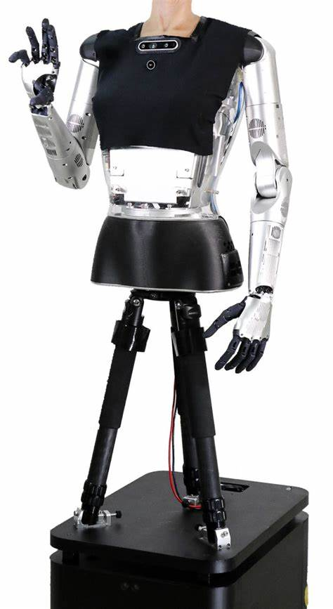

Slide 7
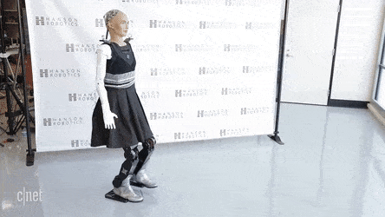
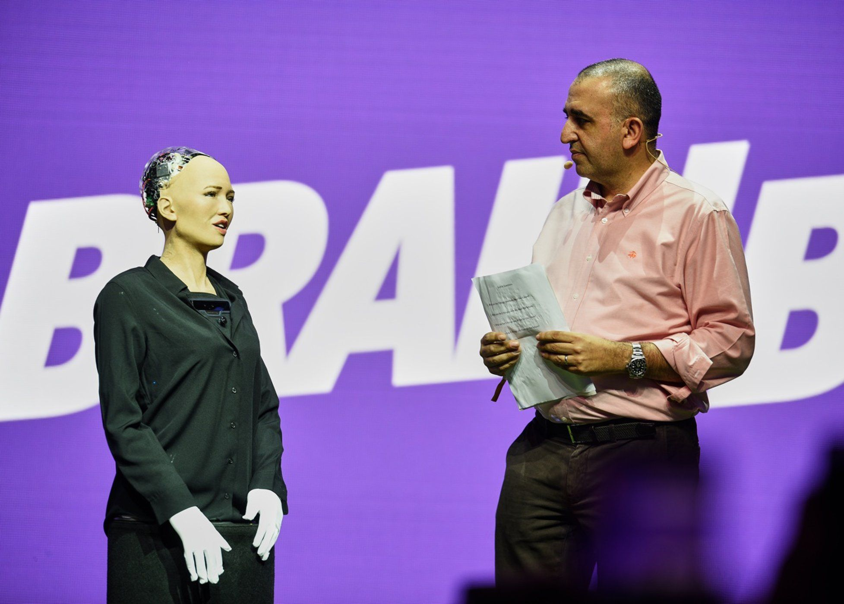

Slide 8
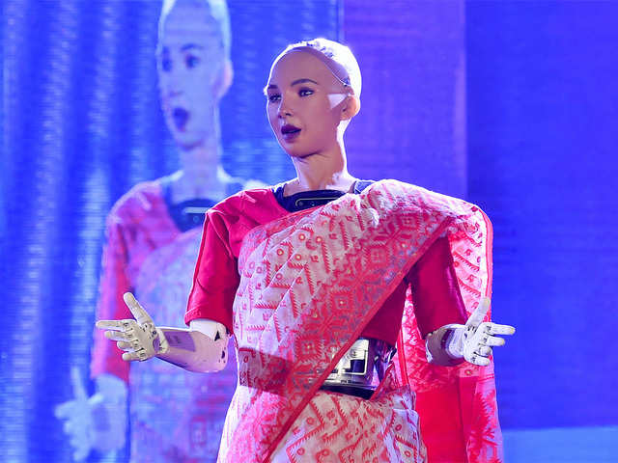
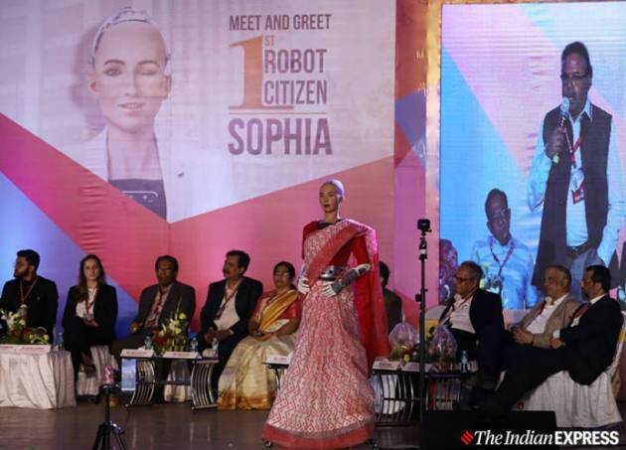
SOPHIA VISIT TO INDIA

Slide 9

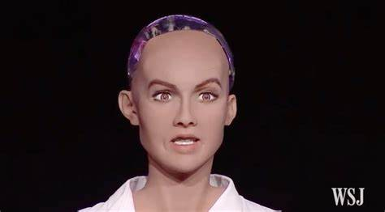
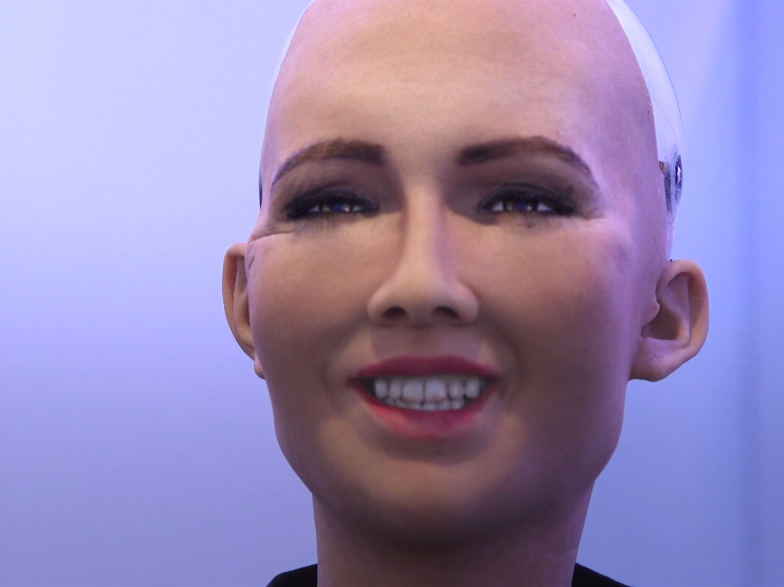

Slide 10
Advantages
Sophia can be used for healthcare sector .
Sophia can solve CBI and FBI cases very easily.
She can be good friend to those children and adults who feel lonely.
She can be a good teacher in villages and city colleges.
She can be a business robot.
As she has artificial intelligence she can generations for millions of years.

Slide 11
Disadvantages
People worry that they will replace jobs.
If they take over middle class citizens jobs our economy will be negatively affected.
It makes people to become lazy.

Slide 12
Conclusion
Sophia marks the beginning of new era in humanity.
Sophia’s debut is gaining worldwide popularity because it has some remarkable human psychological features such as learning by socialization and expressing emotions according to the topic of her conversation.
It is necessary to start talking about robotic rights as a real and close issue,and no longer as an fictional issue.

Slide 13
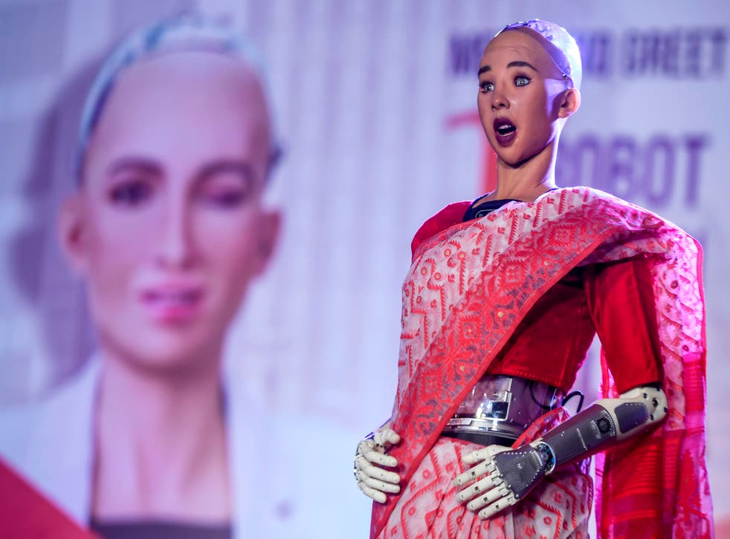
References
www.google.com/sophiarobot

Slide 14
THANK YOU

